Slide 1

Cochrane Methods Project 1: Preferred and Acceptable Risk of Bias Tools for Non-Randomised Studies of Interventions Dr Michele Hilton Boon Ailsa McKay Postdoctoral Fellow, WISE Centre for Economic Justice 9 June 2022

Slide 2
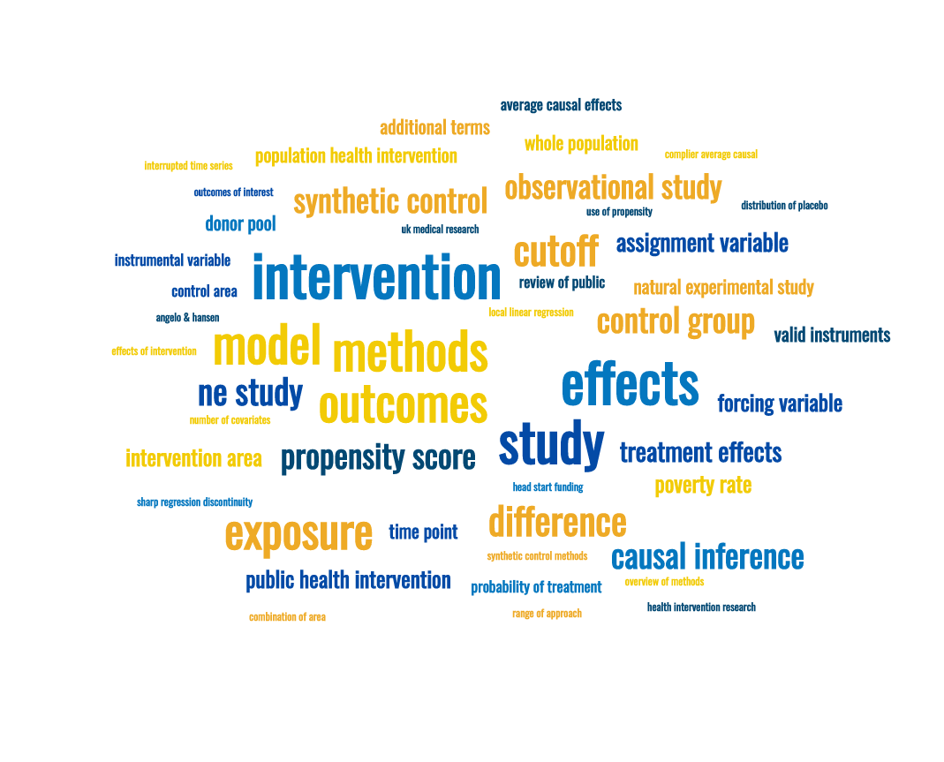

Slide 3
Cochrane Scientific Committee advice
“ROBINS-I is the preferred tool to be used in Cochrane Reviews for non-randomized studies of interventions, although it is not mandatory, and will require author teams to have sufficient knowledge and experience to apply the tool. An alternative option is the Newcastle-Ottawa Scale”
https://methods.cochrane.org/methods-cochrane/robins-i-tool (July 2017)

Slide 4
ROBINS-I
https://www.riskofbias.info/welcome/home
Newcastle-Ottawa Scale (NOS)
http://www.ohri.ca/programs/clinical_epidemiology/oxford.asp

Slide 5
Project aims
Agree a list of criteria against which the acceptability of different NRSI critical appraisal tools can be judged;
Produce an initial matrix of preferred and accepted tools mapped against their appropriateness for different types of NRSI;
Outline additional work required to investigate further and/or provide more robust guidance.

Slide 6
Previous systematic reviews of RoB tools for NRSI
Deeks 2003
“Although many quality assessment tools exist and have been used for appraising non-randomised studies, most omit key quality domains.”
Katrak 2004
“There is no "gold standard' critical appraisal tool for any study design, nor is there any widely accepted generic tool that can be applied equally well across study types. … Therefore, consumers of research are faced with frustrating decisions when attempting to select the most appropriate tool for their needs.”
Quigley 2019
“There is little consensus regarding which is the most appropriate critical appraisal tool to use for NRS. The different methodological quality and variability in reporting of NRS make consistent assessment of ROB difficult.”

Slide 7
Grouping potential criteria for determination of preferred/ acceptable tools
Structure and presentation of tool
(formatting, guidance, training materials)
Development methods
(documented; peer-reviewed)
Content of tool
(purpose, evidence base, bias domains)
Performance of tool
(validity, reliability)
User perceptions
(ease of use, time and expertise required)

Slide 8
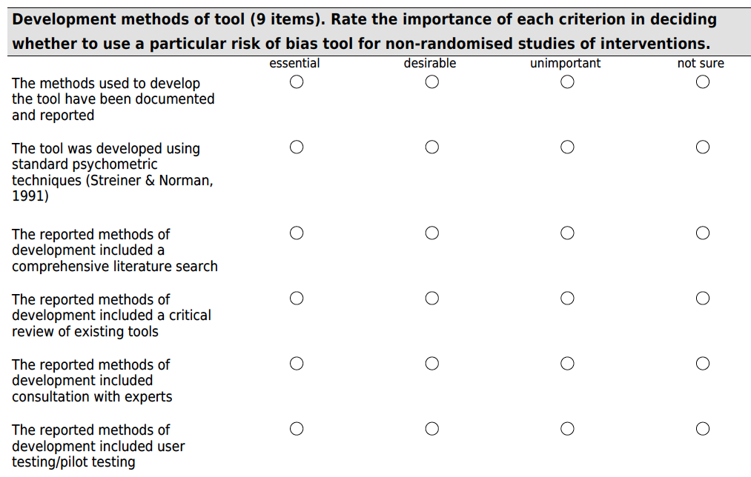

Slide 9
Survey results
41 responses
All but two criteria were either ‘essential’ or ‘desirable’ to a majority of respondents
Expert consensus was to prioritise criteria that >50% of respondents rated ‘essential’
= 22 criteria

Slide 10
Structure and presentation of tool
1. User guidance is provided
2. The user guidance explains the interpretation of each signalling question
3. Training materials are publicly available to support new users
4. The tool supports documentation of evidence from the study used to arrive at a judgment
5. The formatting and output of the tool enable comparison of quality across studies

Slide 11
Development of tool
6. The methods used to develop the tool have been documented and reported
7. The reported methods of development included consultation with experts
8. The reported methods of development included user testing/pilot testing
9. The developers have disclosed any conflicts of interest

Slide 12
Content of tool
10. The tool assesses confounding
11. The tool assesses selection bias
12. The tool assesses information bias
13. The tool assesses reporting bias
14. The tool includes a method for arriving at a summary (overall) risk of bias judgment

Slide 13
Performance of tool
15. The tool’s validity has been formally assessed (e.g. face/content/criterion validity)
16. The tool’s reliability has been formally assessed (e.g. inter-rater/intra-rater/ internal consistency/test-retest/ %agreement assessed)

Slide 14
User perceptions of tool
17. Signalling questions/criteria are easy to interpret
18. The tool has good validity
19. The tool has good reliability
20. The tool is easy to use
21. The time required to complete assessments is feasible within the context of the review
22. The methodological expertise required to complete assessments is feasible within the context of the review

Slide 15
Results of mapping tools to criteria*
ROBINS-I
Met all 16 criteria
NOS
Met 12 of 16 criteria
EPHPP
Met 12 of 16 criteria
Other tools (n=4)
Met between 5 and 9 of 16 criteria
*based on tool websites and studies identified in the literature review

Slide 16


https://www.ephpp.ca/quality-assessment-tool-for-quantitative-studies/

Slide 17
Recommendations
1. In addition to ROBINS-I and NOS, EPHPP should be considered an acceptable tool for RoB assessment of NRSI.

Slide 18
Recommendations
2. Review teams considering the use of any other RoB tool for NRSI should assess the tool against the 22 identified criteria, taking into account how the tool compares with existing preferred and acceptable tools for Cochrane reviews.

Slide 19
Recommendations
3. The choice of RoB tool and rationale for the choice should be documented in the Methods section of the review with reference to the criteria matrix, coverage of the study designs to be assessed, and any other relevant considerations.

Slide 20
Recommendations
4. Any limitations of the selected RoB tool should be noted in the Discussion section together with any considerations of how the review’s results and conclusions may or may not have been affected by the choice of tool.

Slide 21

Questions and discussion
@MHiltonBoon
Email: mbo5@gcu.ac.uk
Repository: github.com/michelehb

